Slide 1
Direct marketing campaign analysis
Insights from excel based analysis
BY ajayi tolulope

Slide 2
CONTENT
Data Cleaning and Preparation
Visual
Dashboard
Project Overview
Recommendations & Next Steps

Slide 3
PROJECT OVERVIEW
Objective:
Analyze customer responses to a bank’s telemarketing campaign
Identify patterns in successful term deposit subscriptions
Dataset:
4511 records
Variables: Age, Job, Marital Status, Month, Duration, Outcome (Success/Failure), etc.

Slide 4
Data Cleaning & Preparation
Steps Taken:
Removed duplicates and blanks
Standardized texts using =PROPER()
Converted date fields to day and month format
Created new columns categorizing age in Youth, Adult and Elderly

Slide 5
Visual
Key Findings:
Previous conversion rate by month – Showed that the new campaign had a better outcome as compared to the previous outcome
Conversion rate by month – Highest conversations in May and August
Customer segmentation showed that the elderly(Retired) had better outcomes than adults

Slide 6
Visual
Key Findings:
Education- Tertiary education had a better outcome of 14% as compared to secondary education of 10% with primary education being the lowest
Management, Blue-collar and Technician jobs had the higest success rate as compared to the others

Slide 7
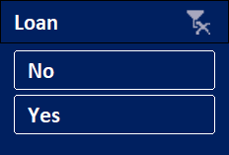
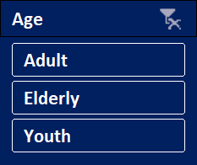
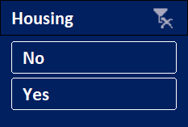
DASHBOARD
DIRECT MARKETING CAMPAIGN DASHBOARD

Slide 8
Recommendations and next steps
Recommendations:
Target months like May and August for future campaigns
Prioritize the elderly and Adults
Expand to other campaign activities to have better results

Slide 9
THANK YOU

